Slide 1
Hierarchical Clustering

Slide 2
Agenda
What is clustering?
Types of clustering
Example with Simpsons family
Types of linkage
Output of python code
Clustering difference
References

Slide 3
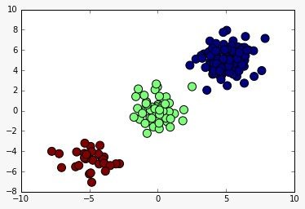
What is Clustering?
The process of grouping a set of objects into classes of similar objects.
Organizing data into clusters such that there is
High intra-cluster similarity
Low inter-cluster similarity

Slide 4











Types of Clustering
Partitional algorithms: Construct various partitions and then evaluate them by some criterion
Hierarchical algorithms: Create a hierarchical decomposition of the set of objects using some criterion
Hierarchical Partitional

Slide 5
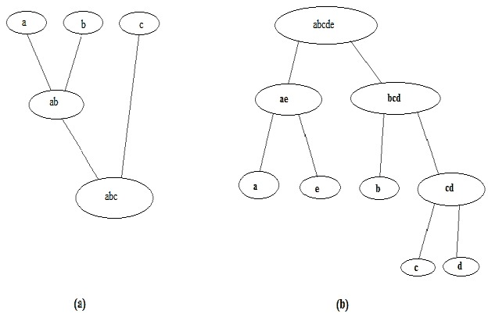
What is Hierarchical Clustering?
In data mining and statistics, hierarchical clustering is a method of cluster analysis which seeks to build a hierarchy of clusters.
Two types of Hierarchical clustering are:
Divisive Agglomerative

Slide 6
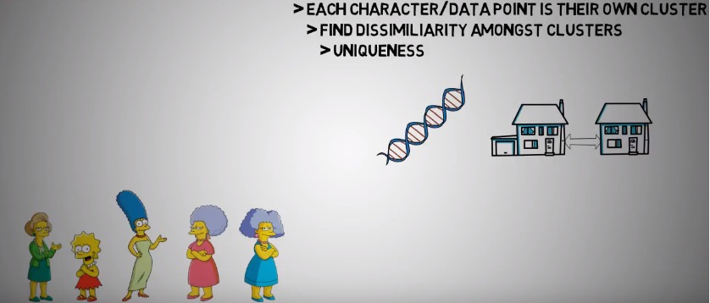
Example: Hierarchical Clustering Simpsons Family

Slide 7
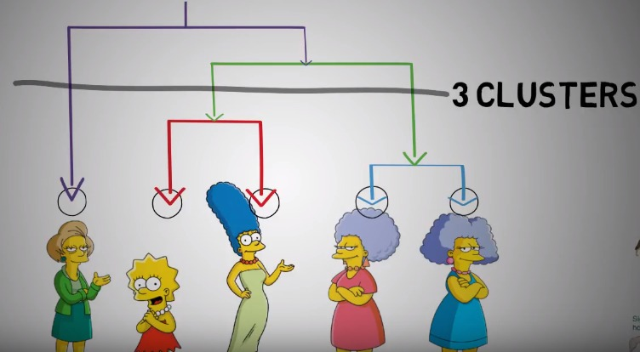
Lisa’s Teacher
Lisa
Marge
Patty
Selma

Slide 8
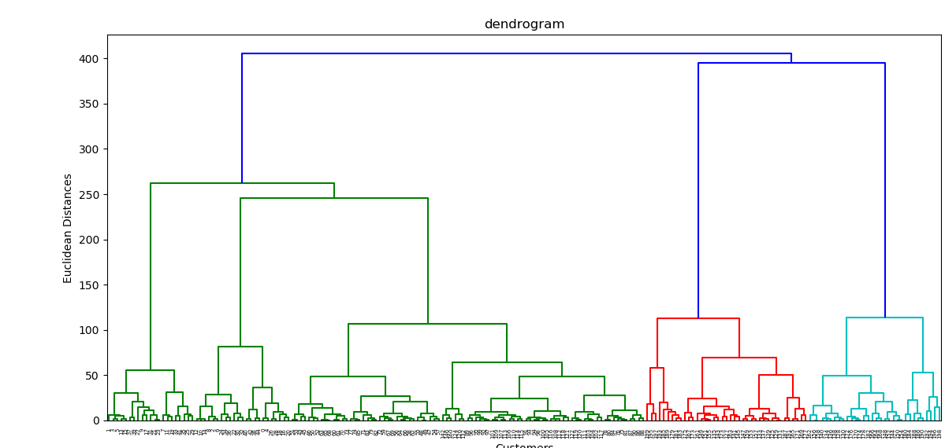
Dendrogram

Slide 9
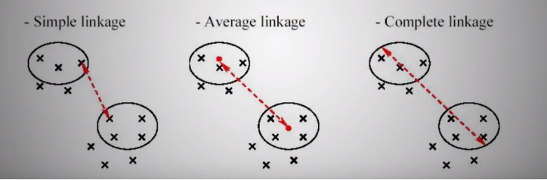
Types of Linkages

Slide 10
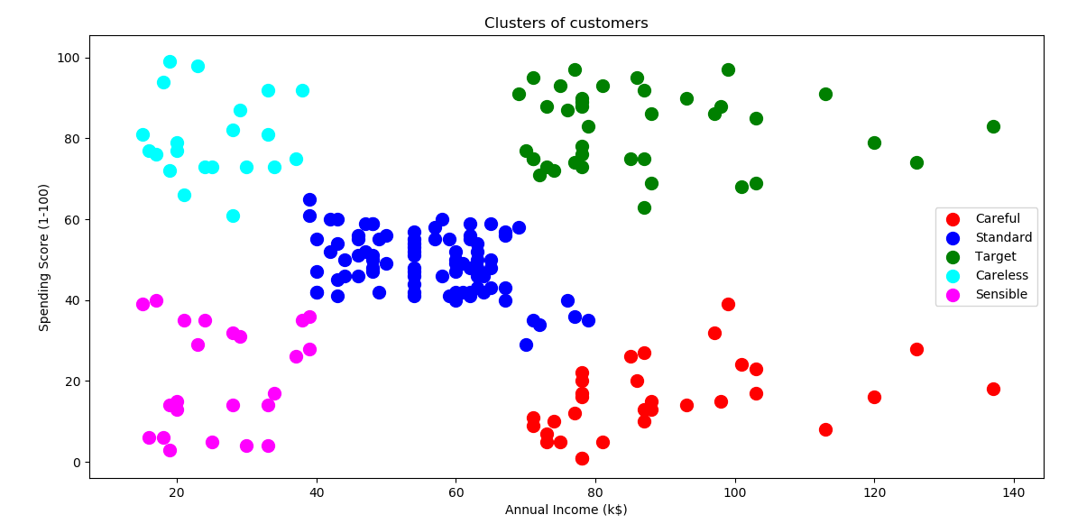
Cluster Diagram

Slide 11
Clustering Comparison
Kmeans Clustering
Hierarchical Clustering
Kmeans clustering needs the number of clusters to be specified
It is usually more efficient run-time wise
Kmeans is used in large datasets
Hierarchical clustering doesn’t need the number of clusters to be specified
It can be slow time-wise as compared to Kmeans
Hierarchical Clustering is used for small datasets.

Slide 12
Applications of Clustering
Data Mining
Image Analysis
Bioinformatics
Text Mining
Weather report analysis

Slide 13
Reference
Hierarchical clustering. (2018, February 26). Retrieved February 27, 2018, from https://en.wikipedia.org/wiki/Hierarchical_clustering
Hierarchical Clustering - Fun and Easy Machine Learning. (2017, September 25). Retrieved February 27, 2018, from https://www.youtube.com/watch?v=EUQY3hL38cw&t=471s
Dendrogram. (2018, February 17). Retrieved February 27, 2018, from https://en.wikipedia.org/wiki/Dendrogram

Slide 14
Thank You Presented By - Kartik Nagras

